Slide 1

PERSUADE to train-the-trainers:
Best advice for RESILIENCE from the Bible Online Learner project

Slide 2

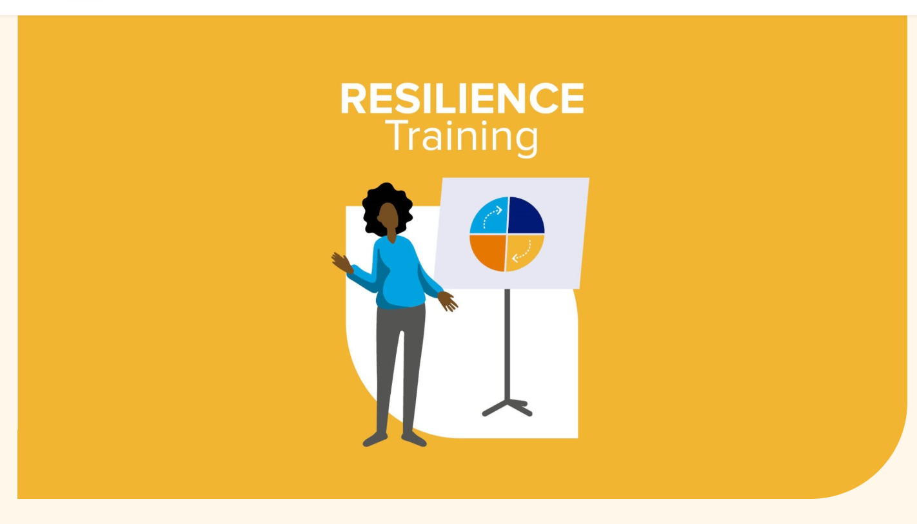
How persuasive design for learning can guide providers of training in the use of digital resources
Nicolai Winther-Nielsen
Resilience training workshop at Condorcet Campus Paris
Download material at https://theonlineprofessor.org/en/blog/train-the-trainer-for-bibleol/

Slide 3

Intro
Hebrew Bible and ICT
  Fjellhaug International University College -2023
  Aalborg University 2001-2015
  Corpus linguistics at VU Amsterdam 1987-
Best advice: include persuasive ethics in RESILIENCE!
BACKGROUND
17 years of development of BibleOL
Successful open source solution in spite of marginal funding
Solution also works in the Global South
  Copenhagen 2008-
  Madagascar 2010-2015
  Ethiopia 2019-
Learned from every mistake there is
An Online Professsor’s mission

Slide 4
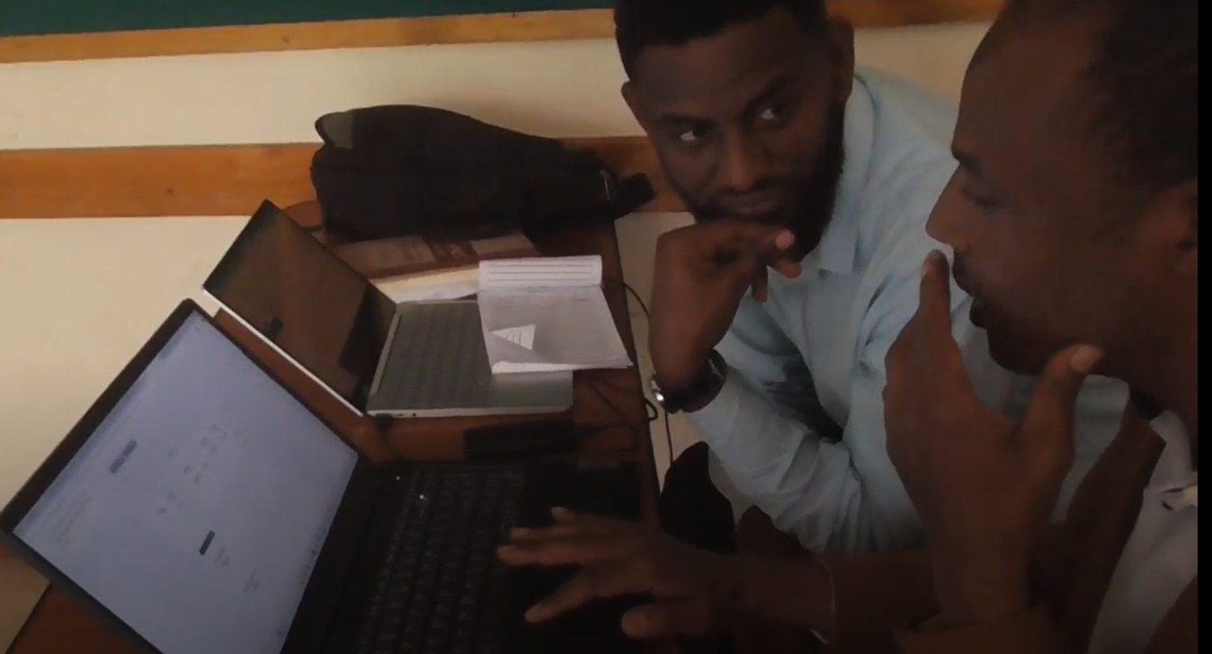
Outline
Design for persuasive learning
The PERSUADE model
How to train-the-trainers
TRAIN-THE-TRAINERS:
  how to persuasively train (in technology)
  the trainers (instructors as facilitators)
  to facilitate the trainees (learners )

Slide 5

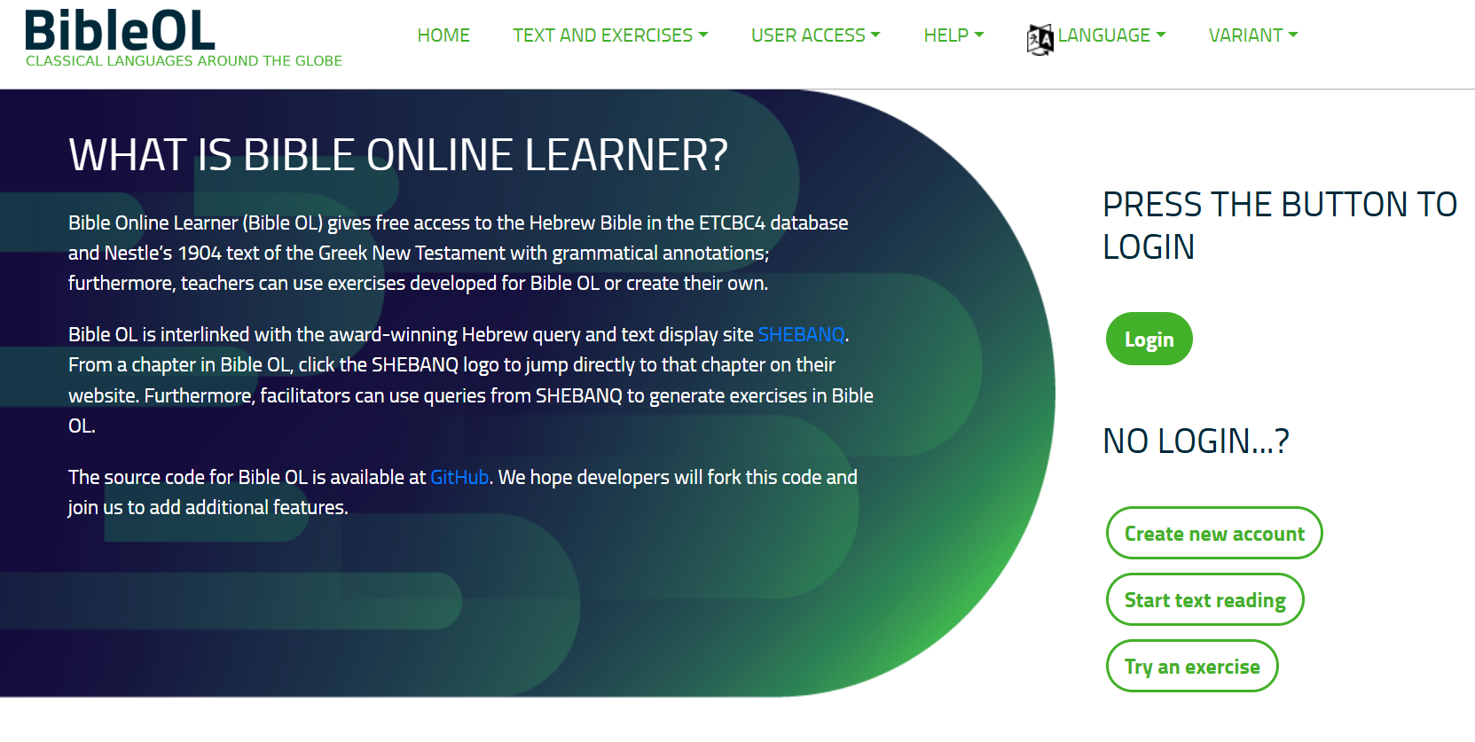
BibleOL as a case
https://learner.bible/

Slide 6
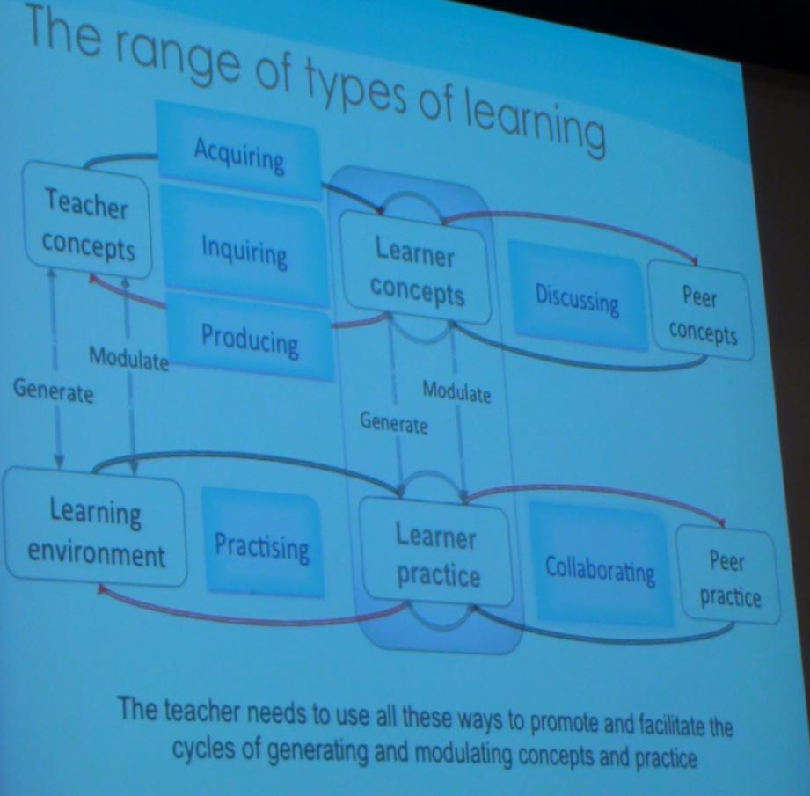
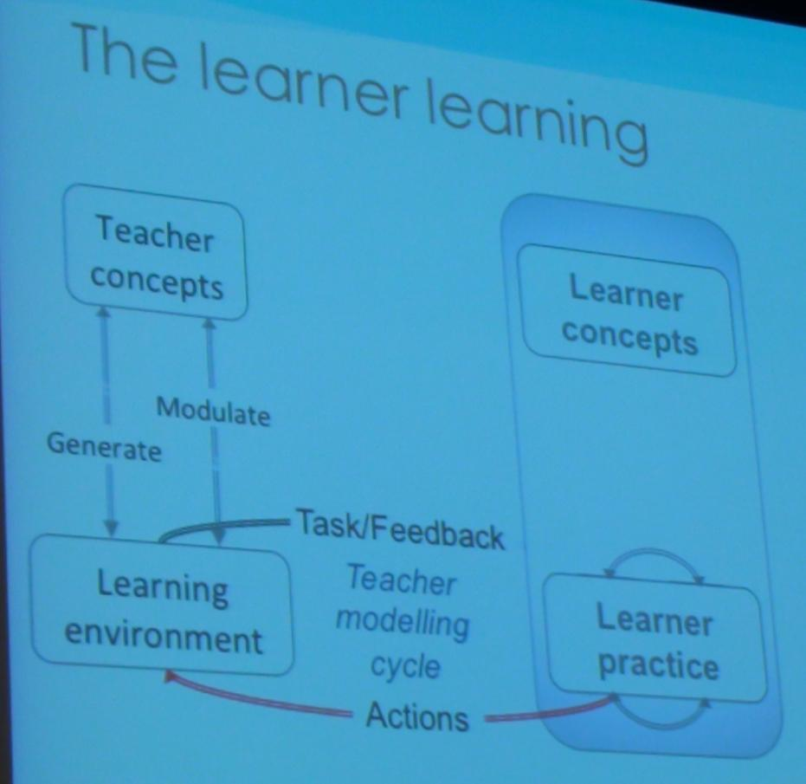

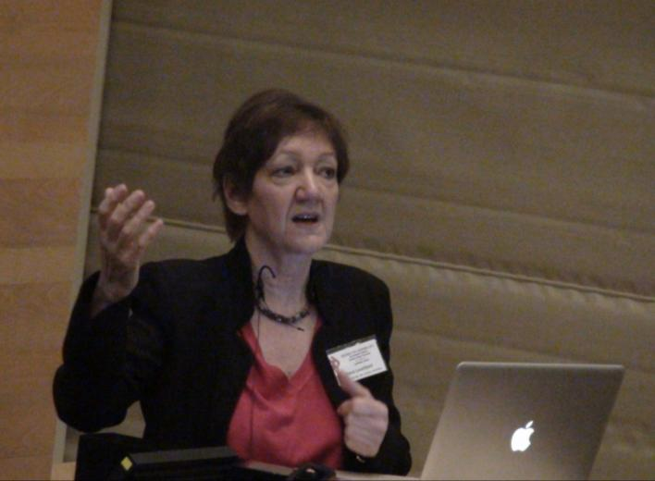
Design for learning
Laurillard: Design science (2012)
The learner learning
Range of learning

Slide 7
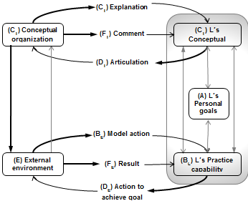
BibleOL designed for learning
FACILITATOR
influences L’s goals
Learning Objects
CHECK/SHOW answer
Interative Hebrew Bible
INTERFACE
drives L’s practice

Slide 8

Persuasive design
Definition
A responsible use of “interactive computing systems designed to change people’s attitude and behaviors” (Fogg, 1).
Technology can “proactively seek to motivate and influence users… It can encourage, provide incentives, and negotiate” (Fogg, 16)
Fogg (2003)

Slide 9
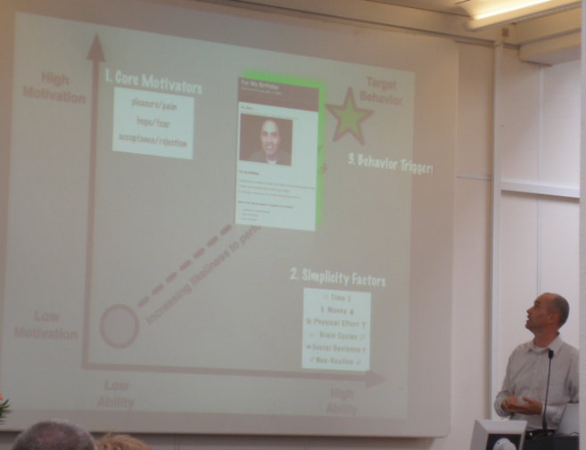
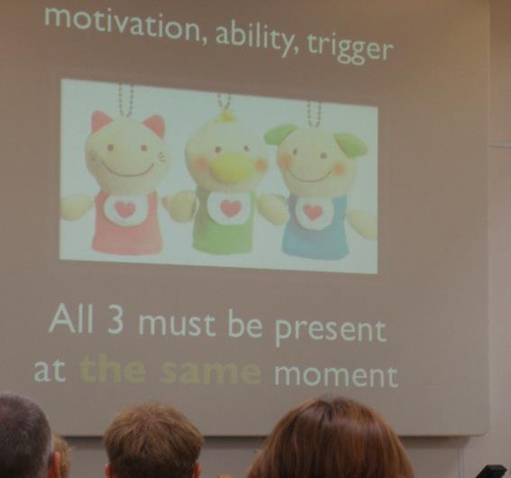
Target
Motivation, ability, trigger

Slide 10
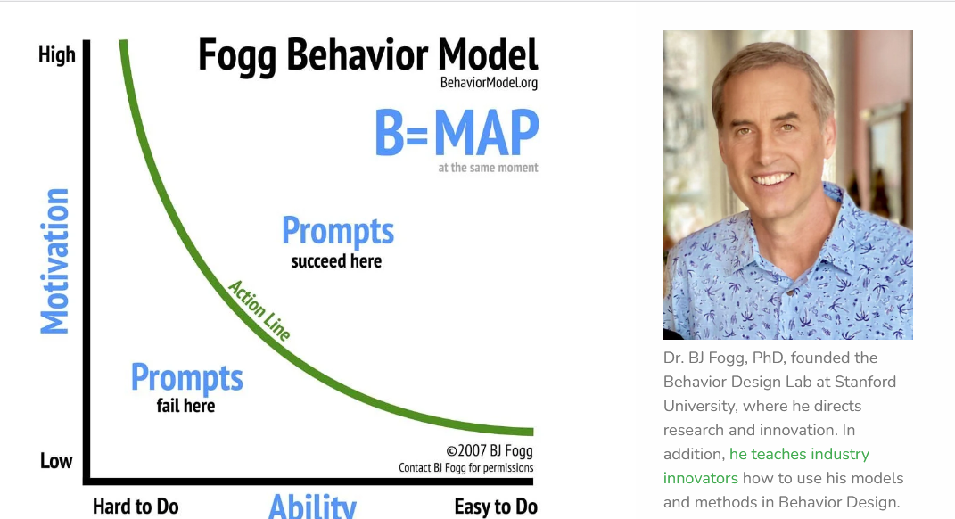
Fogg Behavior Model
Prompts
www.behaviormodel.org/

Slide 11
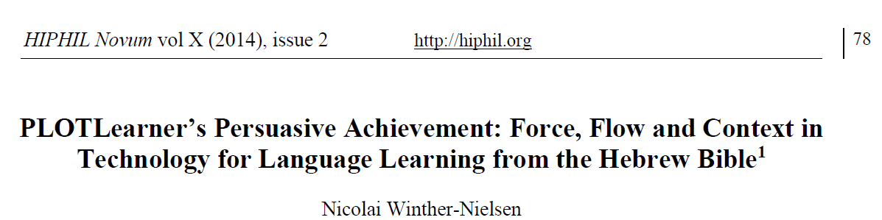
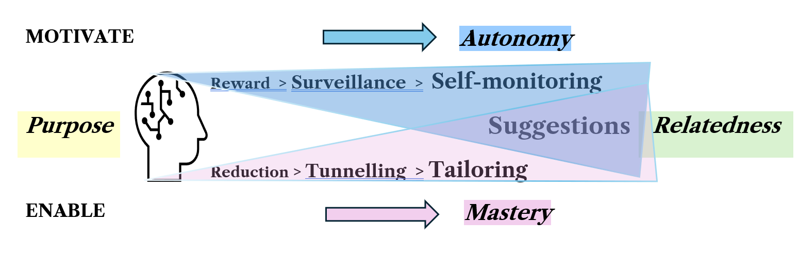
Launching RAMP (2014)
Motivate: reward > surveillance > self-monitoring
Enable: reduction > tunneling > tailoring
SUGGESTION
Relatedness Ability Mastery Purpose

Slide 12
RAMP contexts
Contexts
Learning Content
Learner engagement
Institutional setting
Social environment
Learner
Provider
Social world

Slide 13
PERSUADE (2025)
 | PERSUADE Acronym Core concern
Lear­ne | Purpose engagement appeal
 | (2) Expectation ethical credibility
Design for Persuasive lear­ning | (3) Research evidence theory
 | (4) System empowering content
 | (5) Users effective feedback
 | (6) Assessment efficient tracking
Trai­ning | (7) Demonstration education facilitators
 | (8) Evaluation expansion development
New model and focus: to train-the-trainers

Slide 14
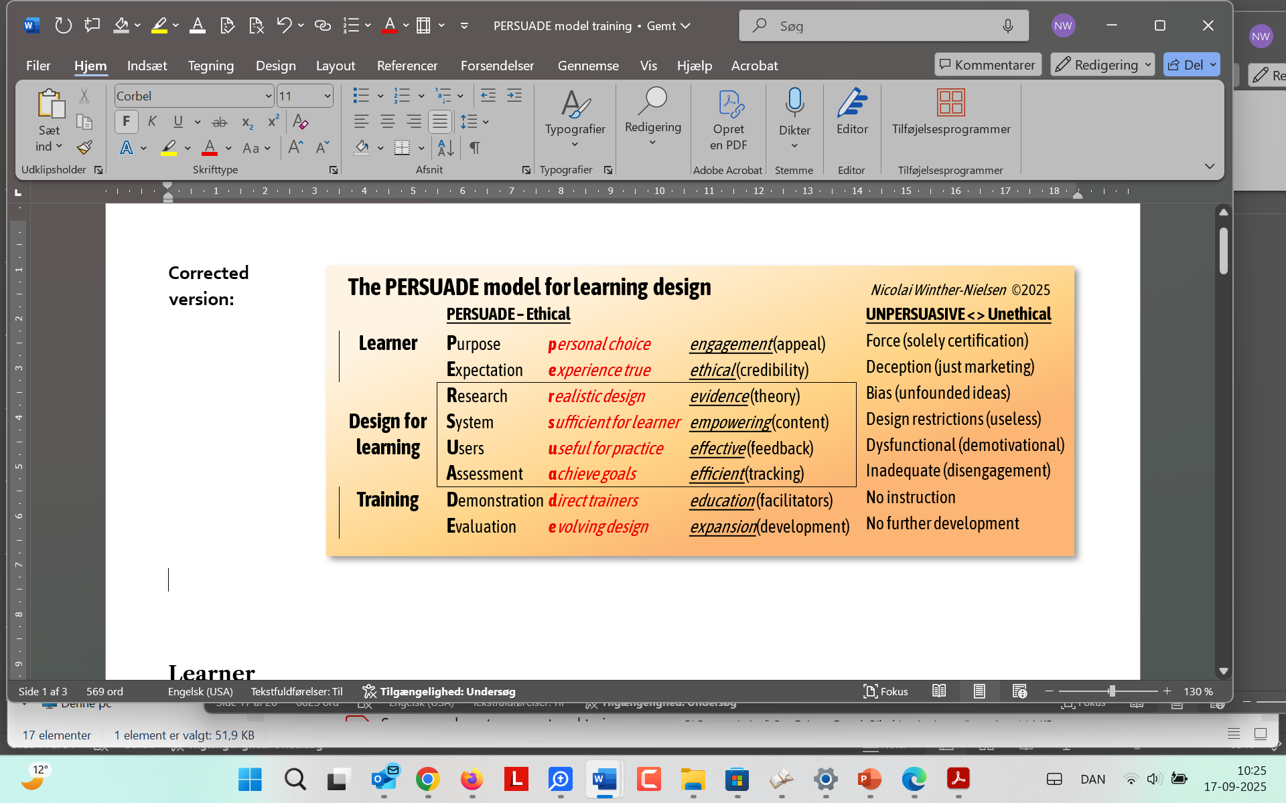
PERSUADE (2025)
Full model

Slide 15
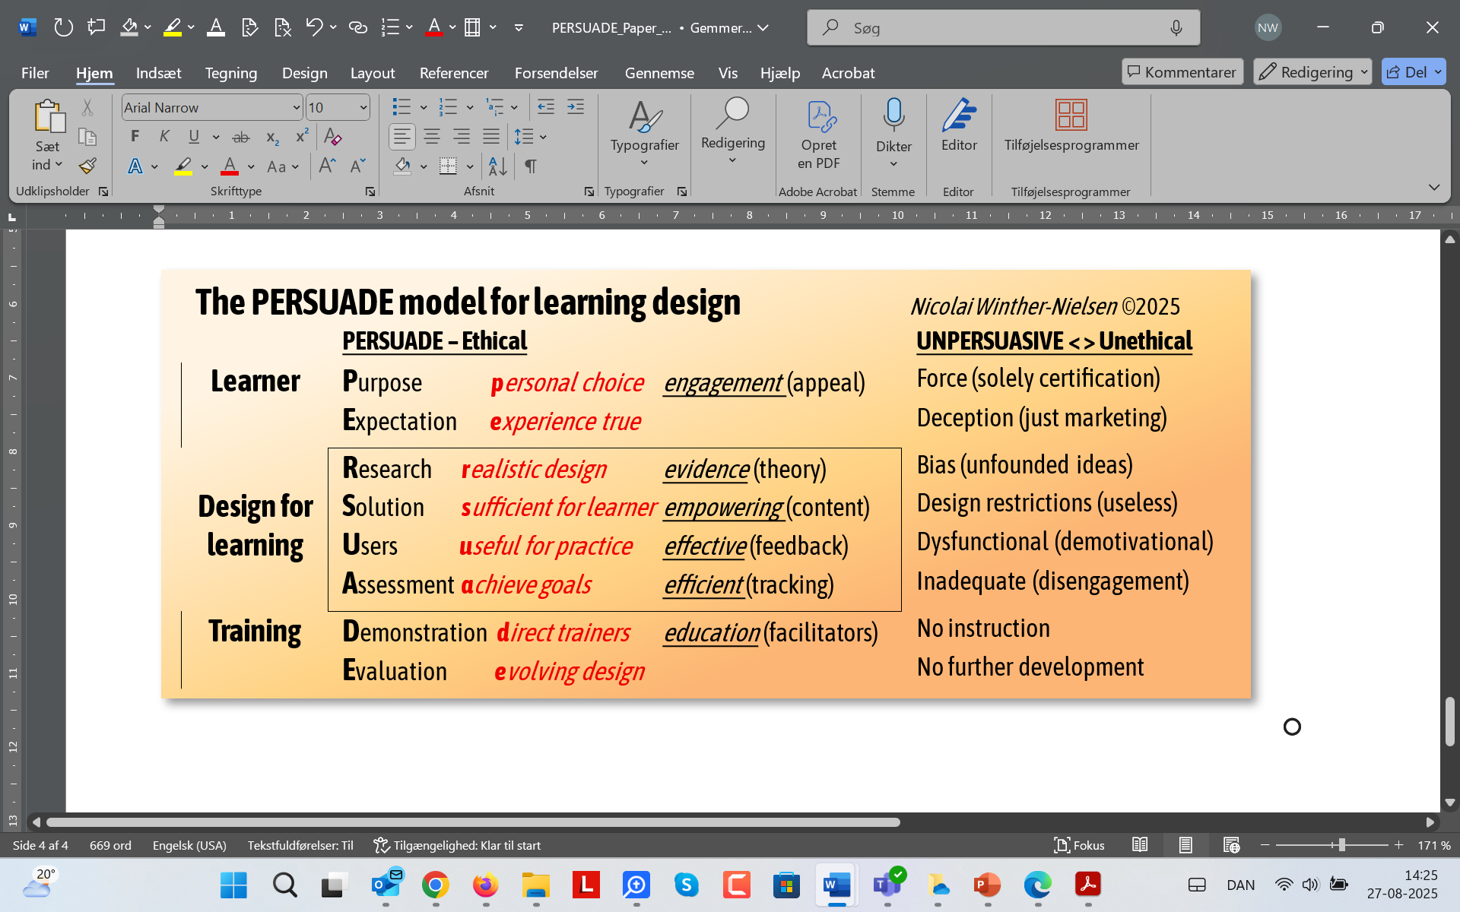
Learner ethics
Exams, deceptive marketing
Engage, true testimonials

Slide 16


Learner ethics

Slide 17
Design for learning
2008-, EuroPLOT 2010-13, Nida 2023
Empover: Adapted to learning tasks
Effective: Feedback on practice
Efficienct: Performance tracking for assessment

Slide 18
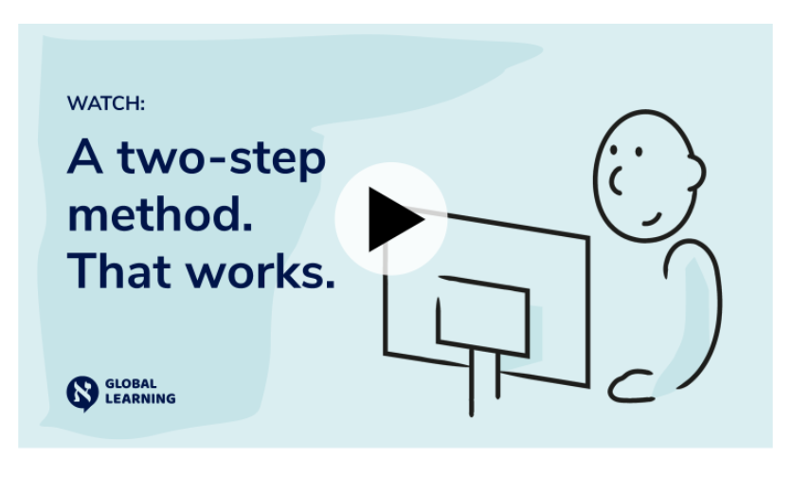
Learn by doing
One minute video on enquiry and practice
Learning Objects (in Moodle) → Interactive learning environment (BibleOL)
https://global-learning.org/

Slide 19
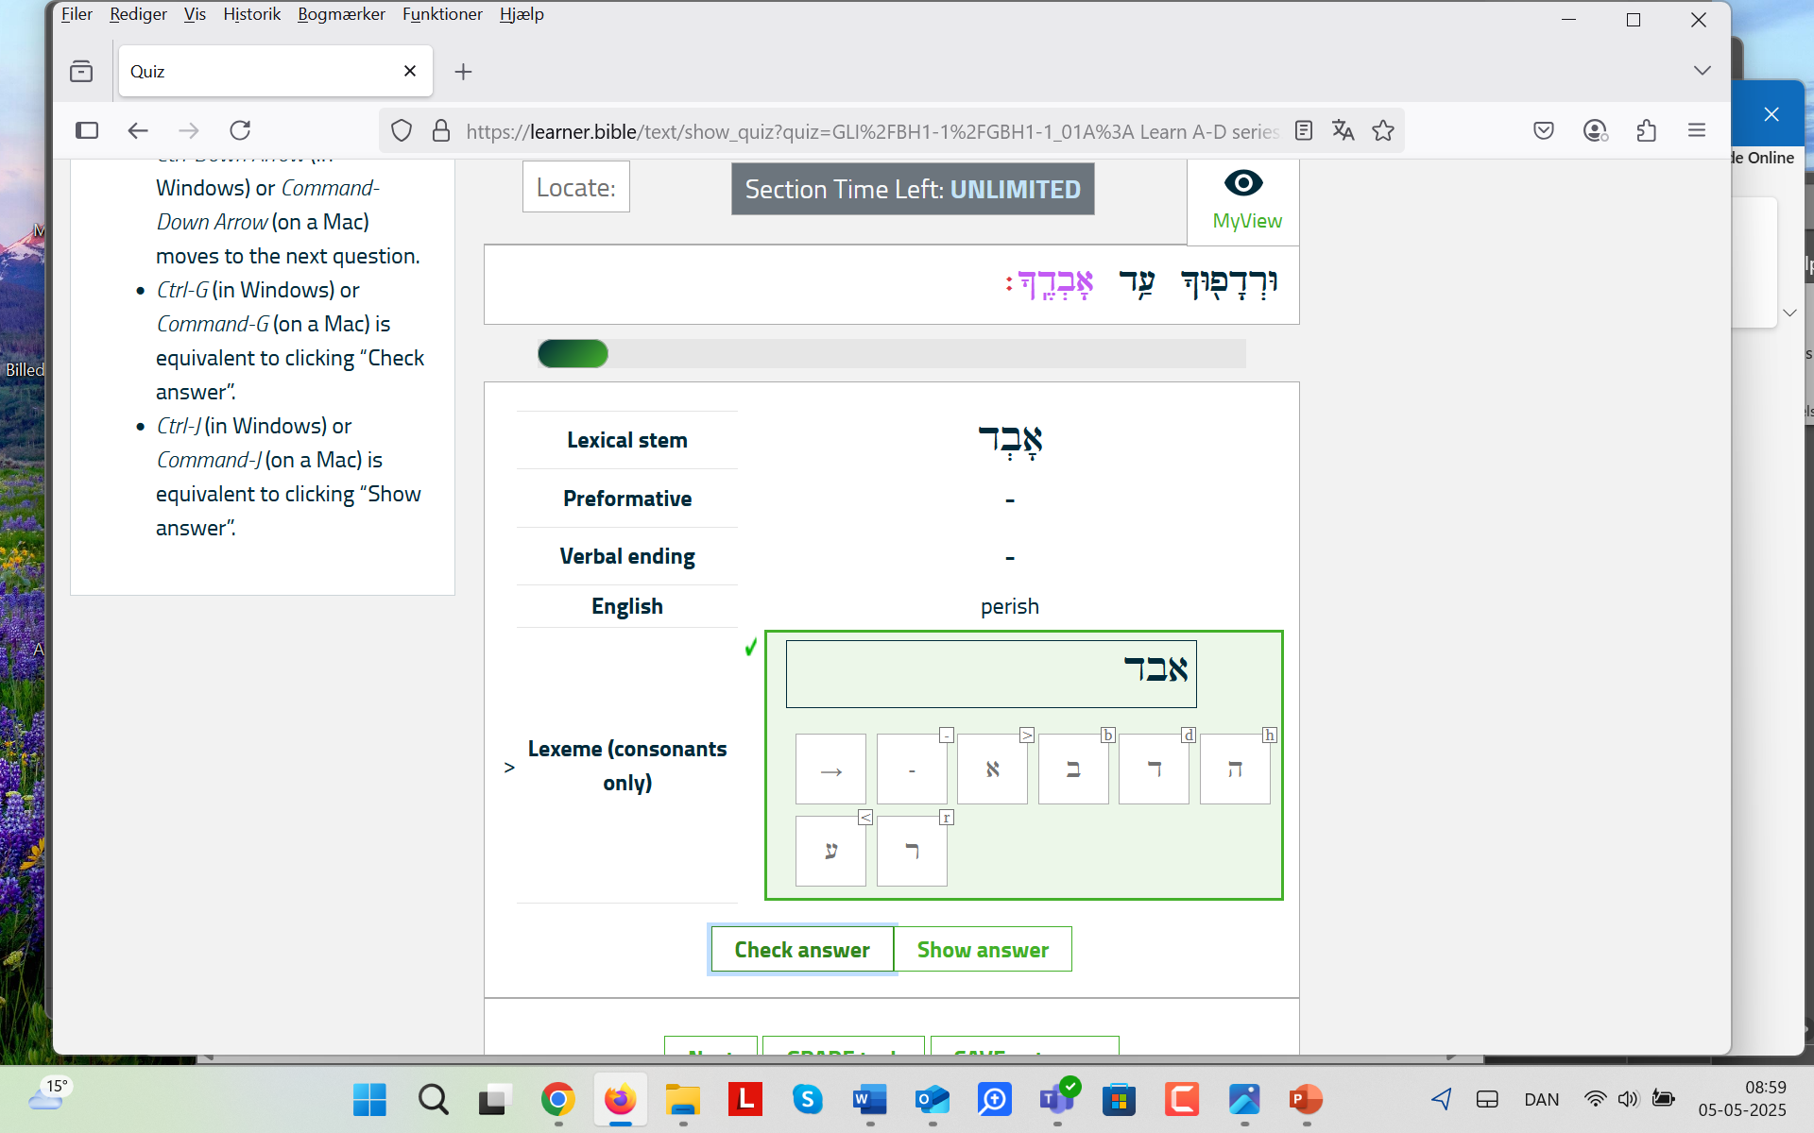
Effective practice
Practical learning (instant feedback)

Slide 20
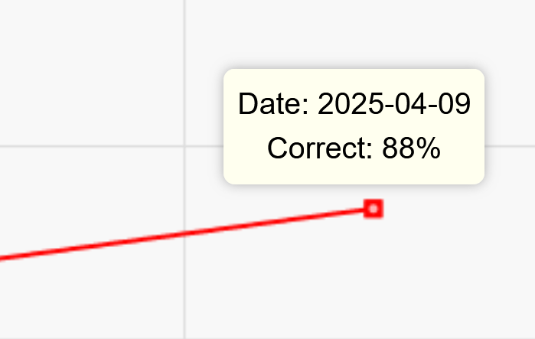
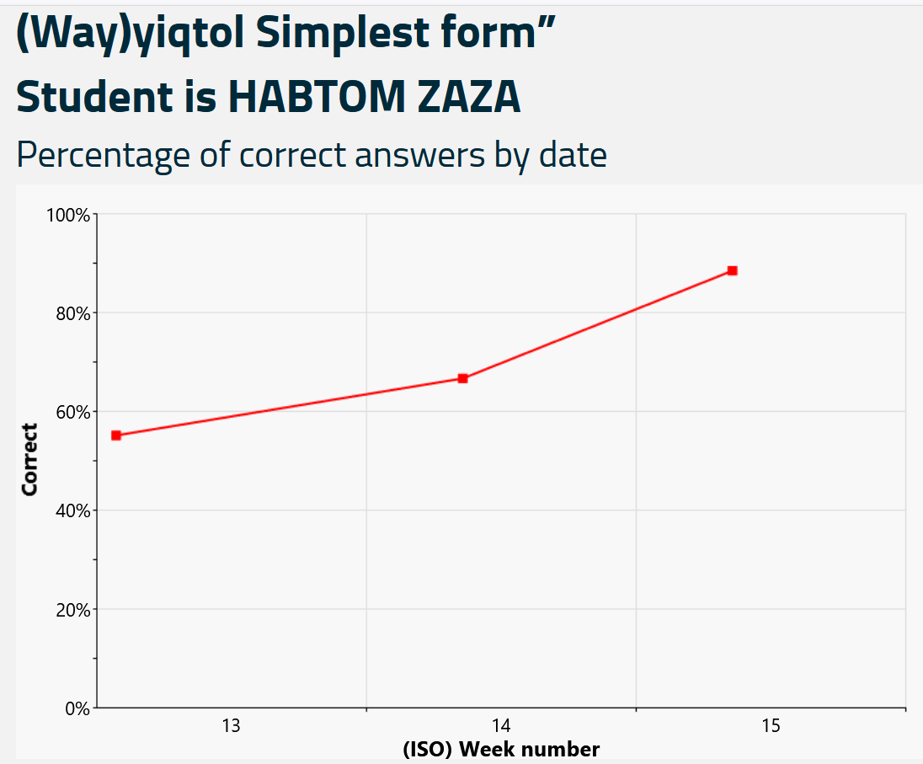
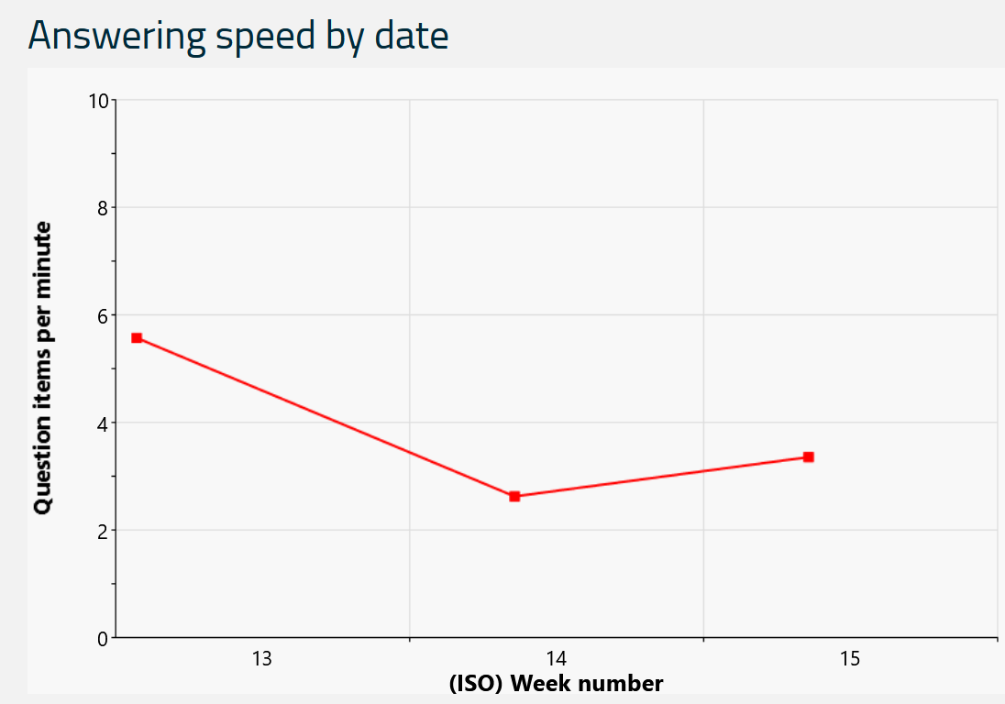
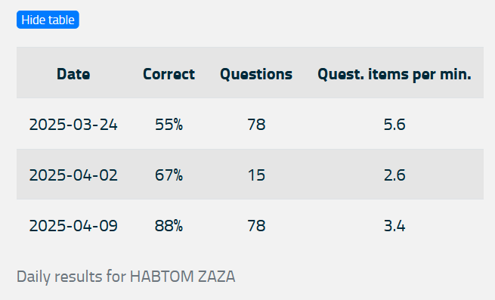
Efficient performance
Formative assessment (performance tracking)

Slide 21
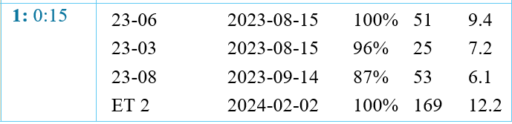
Proficiency
Percentage correct (complete mastery)
Number of questions (in many cases)
Answers per minute (at a reasonable speed)

Slide 22
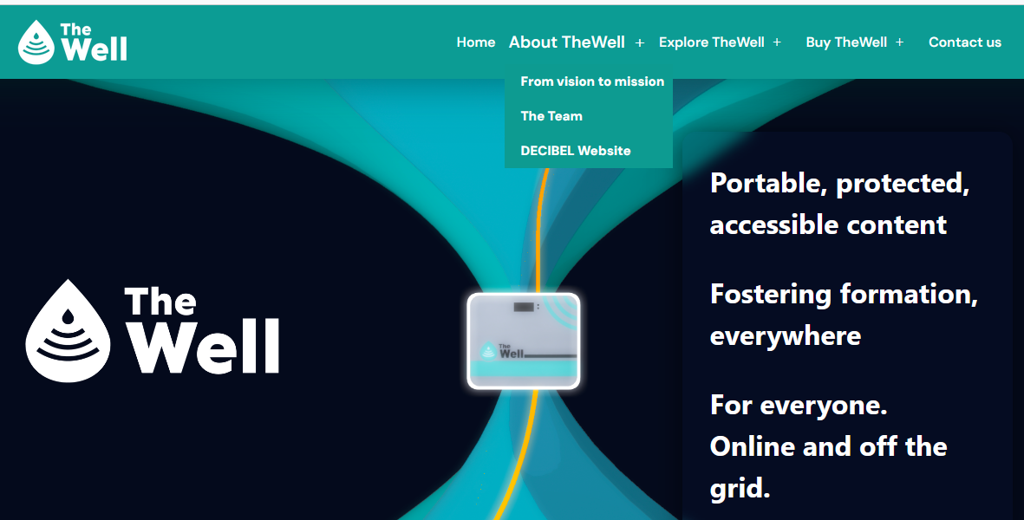

TheWell BibleOL project
OfflineX https://thewell.systems/

Slide 23
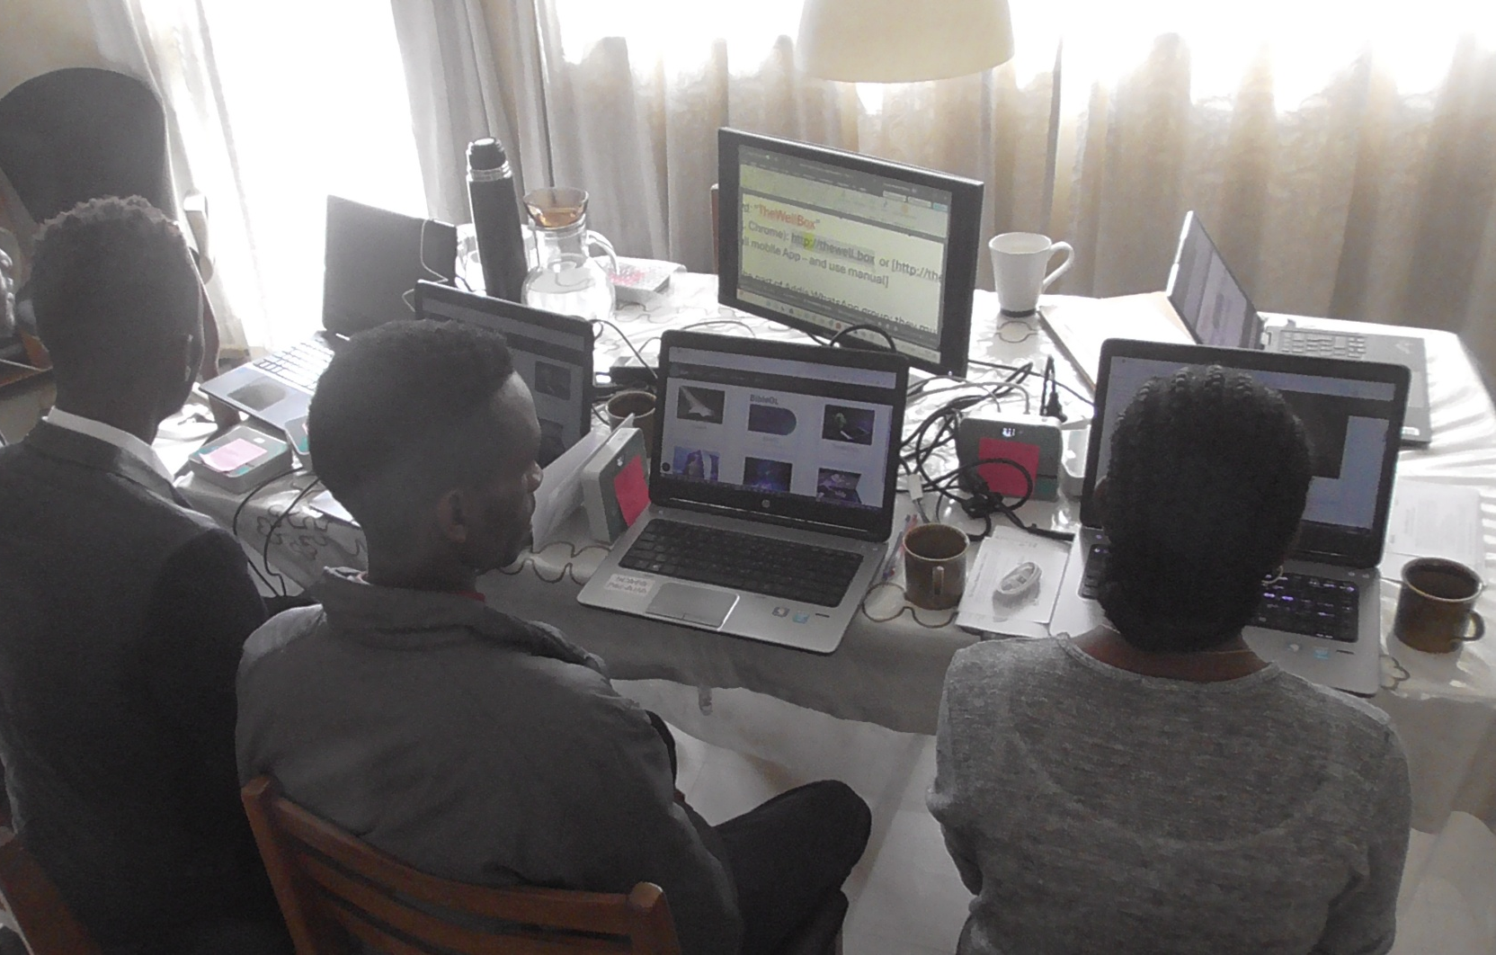
Tested by private students
TheWell test in Ethiopia 2024
Ethical dilemmas:
  Personal mission ≠ institutional vision
  Foreign offer ≠ local needs
  Reward-to-test ≠ intrinsic motivaltion
  Competiton ≠ collaboration

Slide 24
Training
Need for training, improve design
Demonstration to direct the trainers

Slide 25
Trainer practice and evaluation
Kirkpatrick model Four-level-evaluation
Response: did they like it (participant reaction)? Questions on Best/Worst
Learning: what knowledge or skills did they retain? Evaluation in tests, observations and interviews
Behavior: how are trainees performing differently? Participants can apply as trainees-to-train
Results: what is the impact on the bottom line? Cost-benefit analysis
Trainer practices skills:
Learning teams
Peer-based instruction
Instructor-pool
Evaluation
Kirkpartrick model applied

Slide 26

RESILIENCE training
www.resilience-ri.eu/training-programme/

Slide 27

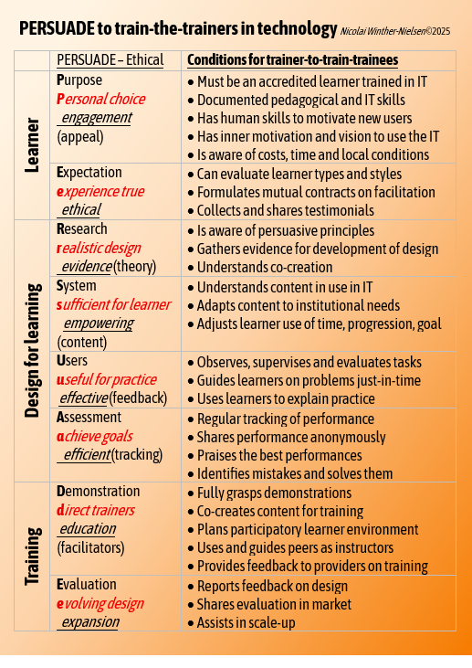
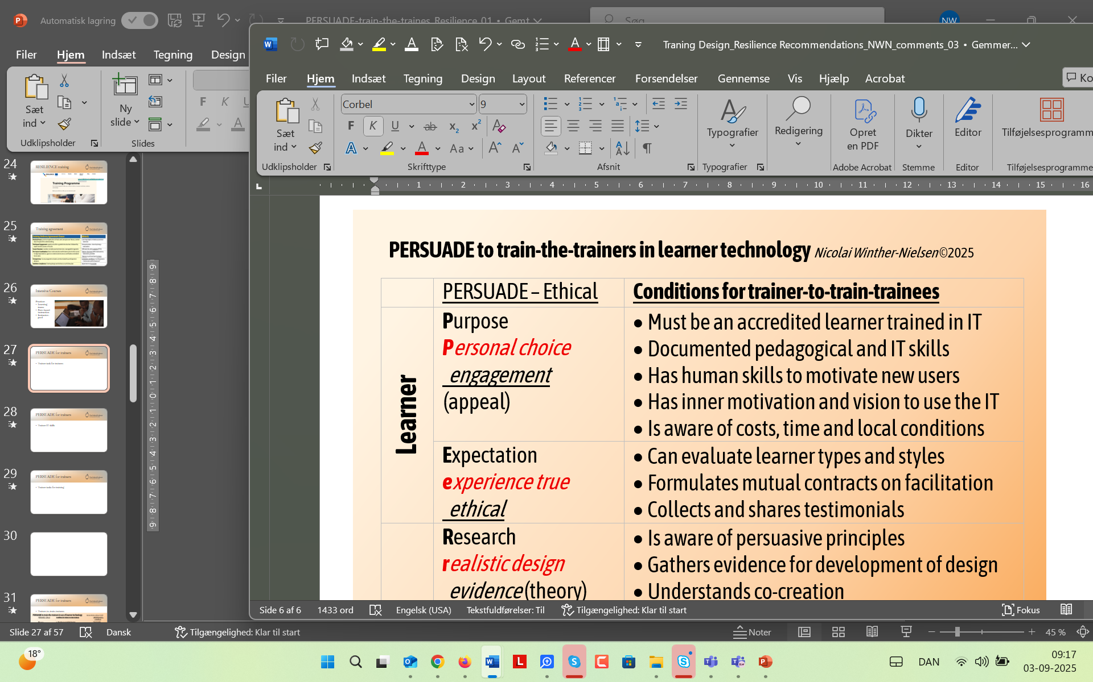
PERSUADE for trainers
RESILIENCE Training Services
PERSUADE to train-the-trainers in technology

Slide 28
PERSUADE for trainees
Trainer task for trainees

Slide 29
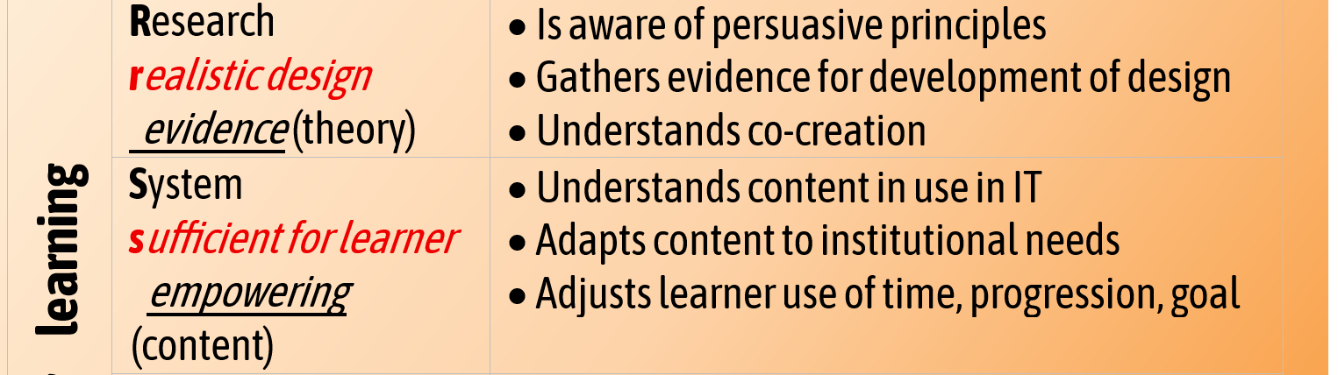
PERSUADE for IT-systems
Trainer IT-skills: Research and solution

Slide 30
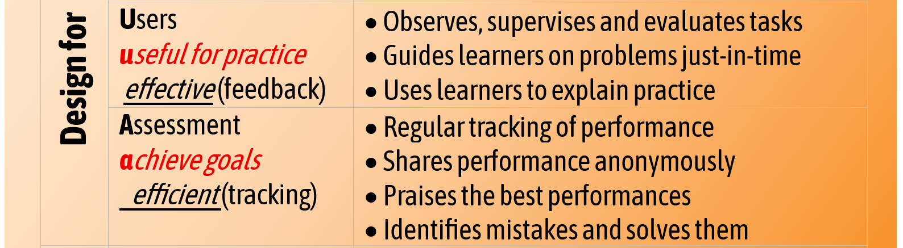
PERSUADE for IT-users
Trainer IT-skills: Users and Assessment

Slide 31
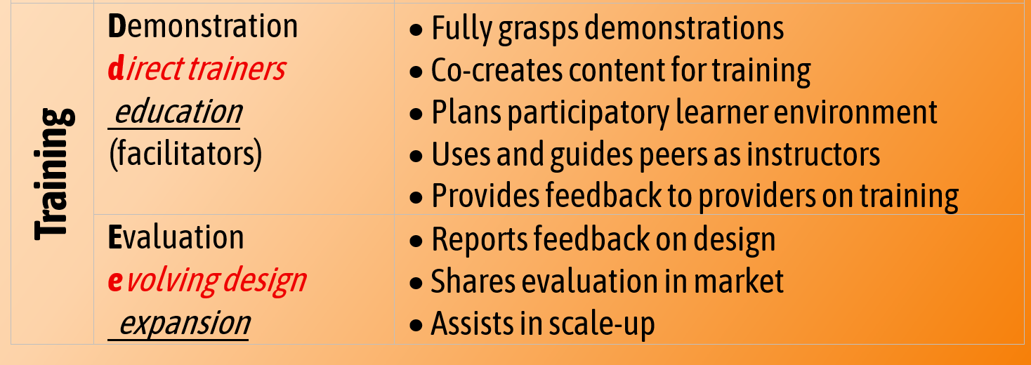
PERSUADE for trainers
Trainer tasks for training

Slide 32
Summary
PERSUADE for trainers
Purpose: The trainer must be learner! Skills in IT literacy and teaching
Expectation: Influence attitude of learners, define local conditions and promote training
Research: understand how technology works, contribute to learner-driven development
System: know how learning content is available and adjust to needs of learners
User: facilitate trainees in how to maintain practice
Assessment: use performance tracking to assist learners reach goals for mastery
Demonstration: use and improve training , spot and train new potential trainers
Evaluation: share feedback from learners.

Slide 33
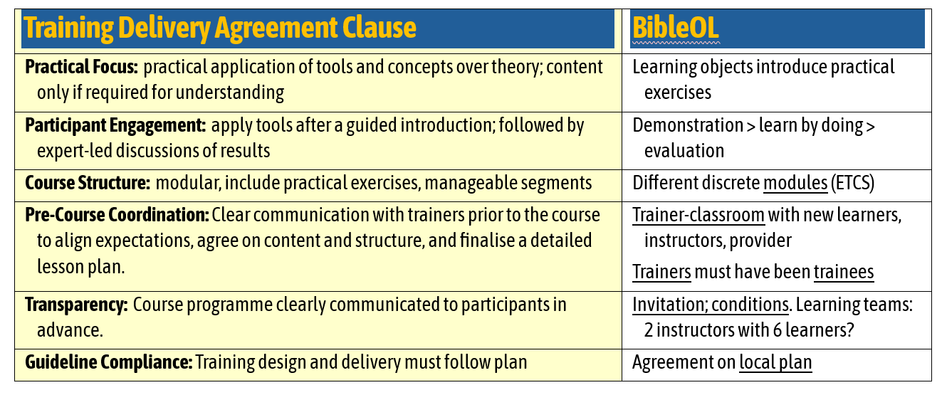
Training agreement
Local adaption

Slide 34

Global training
https://theonlineprofessor.org/thewell/

Slide 35
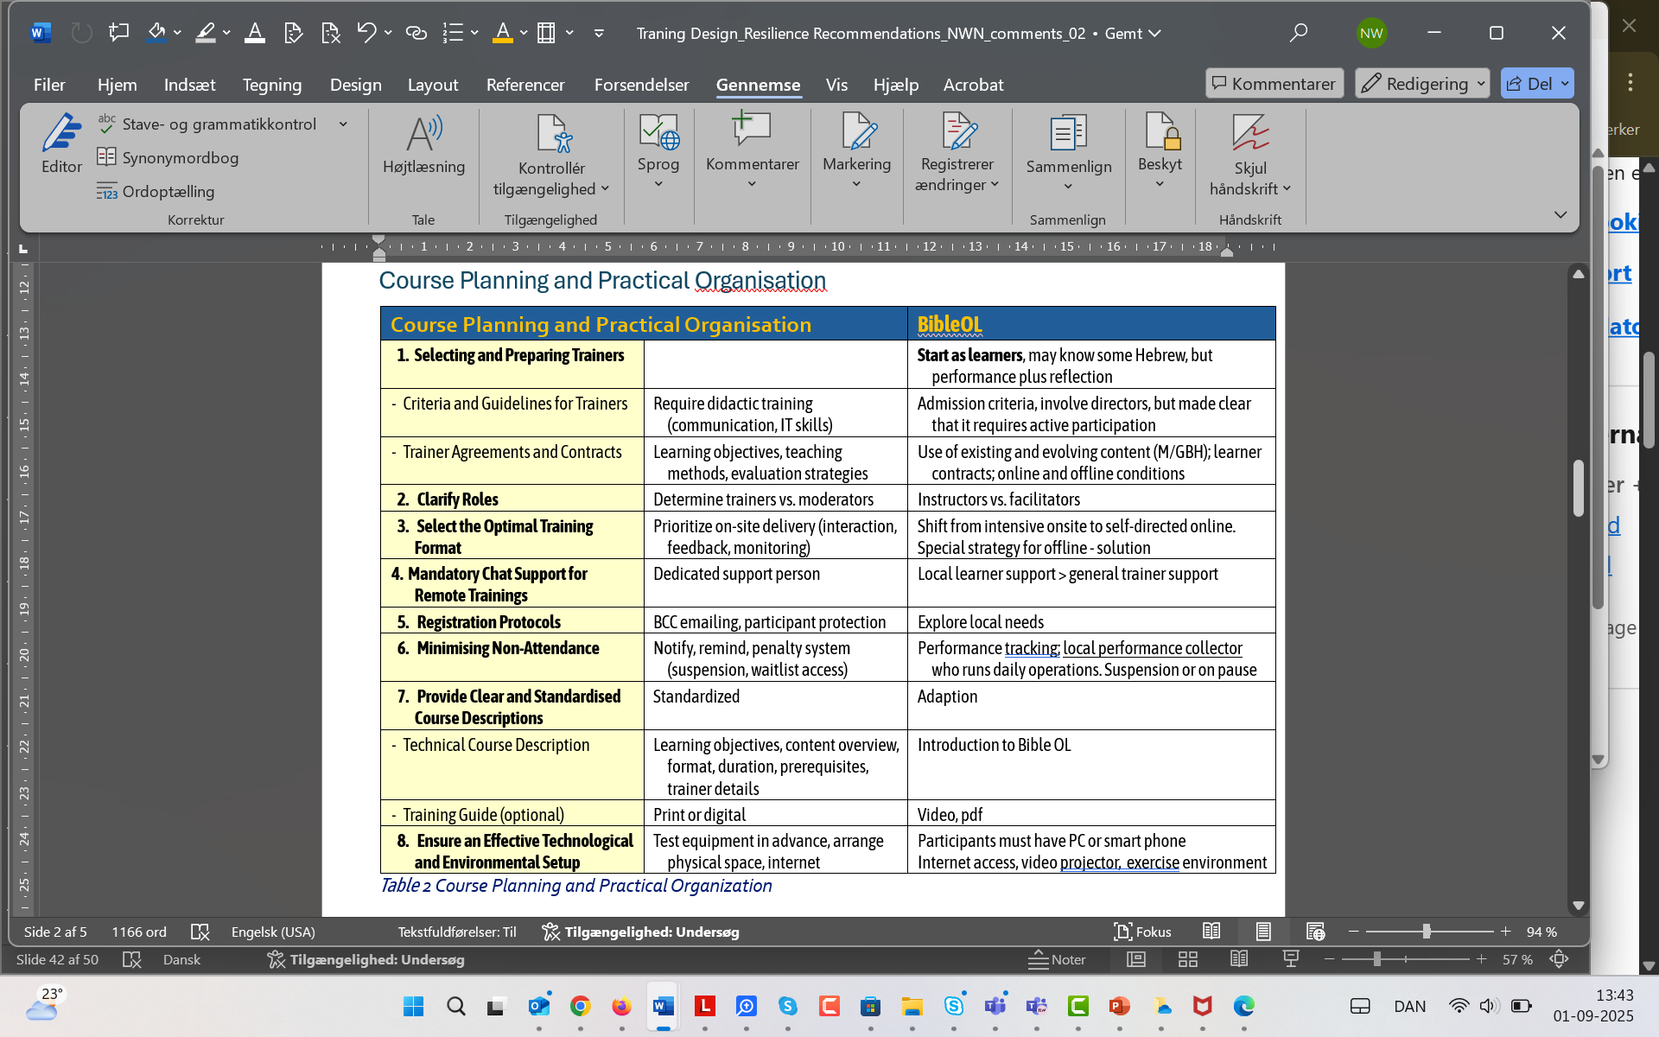
Course planning
…To be continued

Slide 36
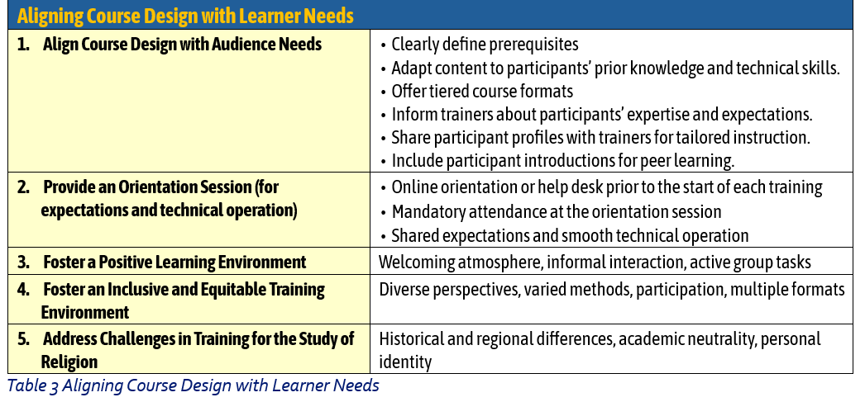
Allign to learners

Slide 37
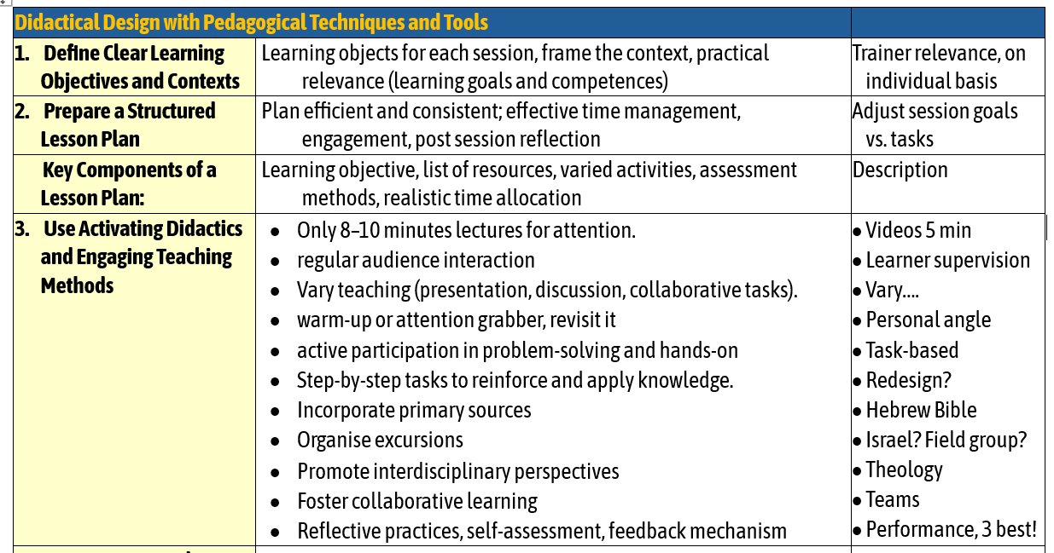
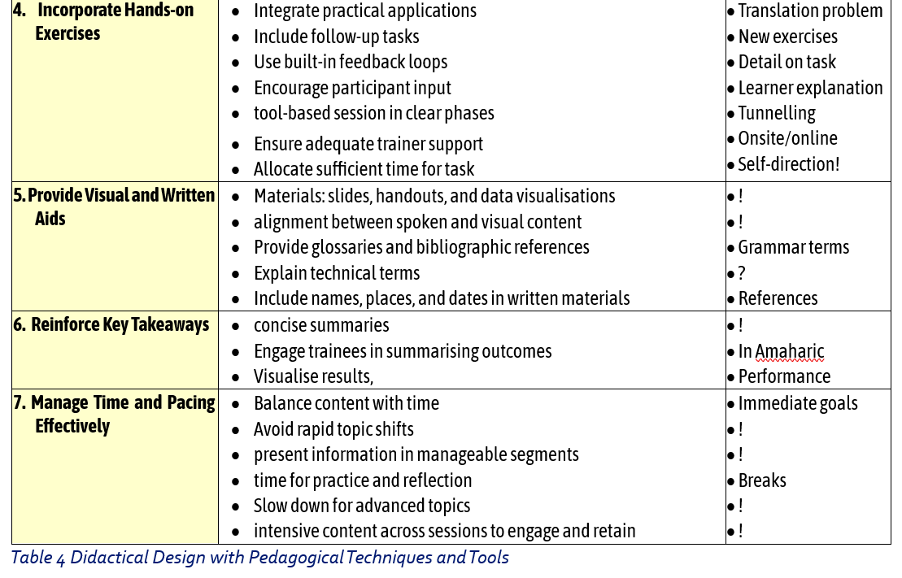
Didactic design
…To be continued

Slide 39
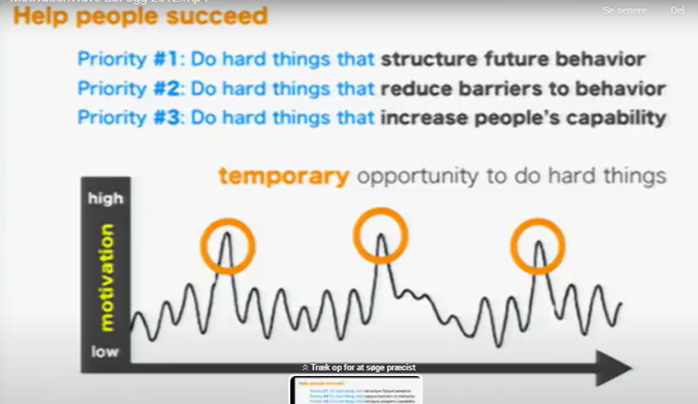
Succeed in learning?
Self-directed learning activity to (Fogg)
  avoid barriers
  improve capabilitiy
  plan better tasks

Slide 40
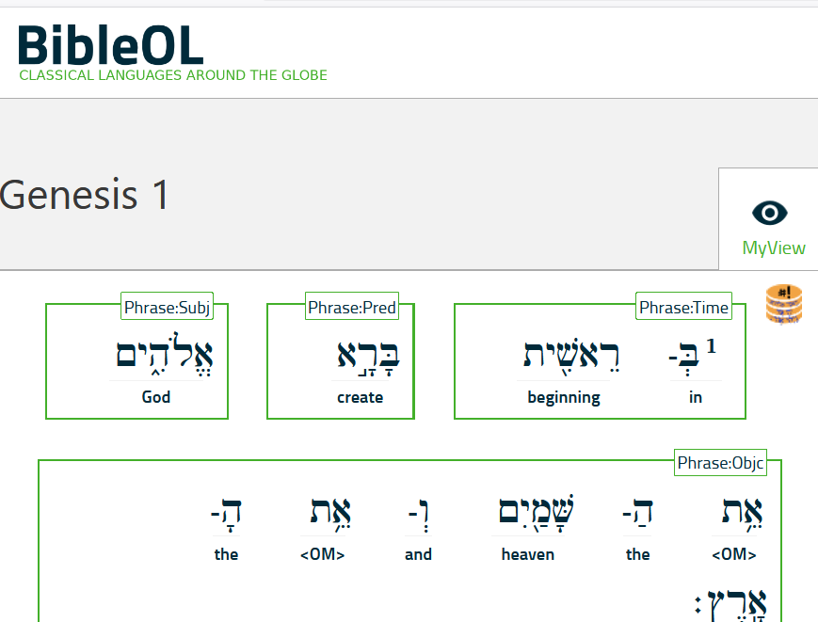
Persuasive Technology
Bible Online Learner
https://learner.bible/

Slide 41

GBH 1-1
Global Biblical Hebrew
First half of beginners’ level
Content

Slide 42
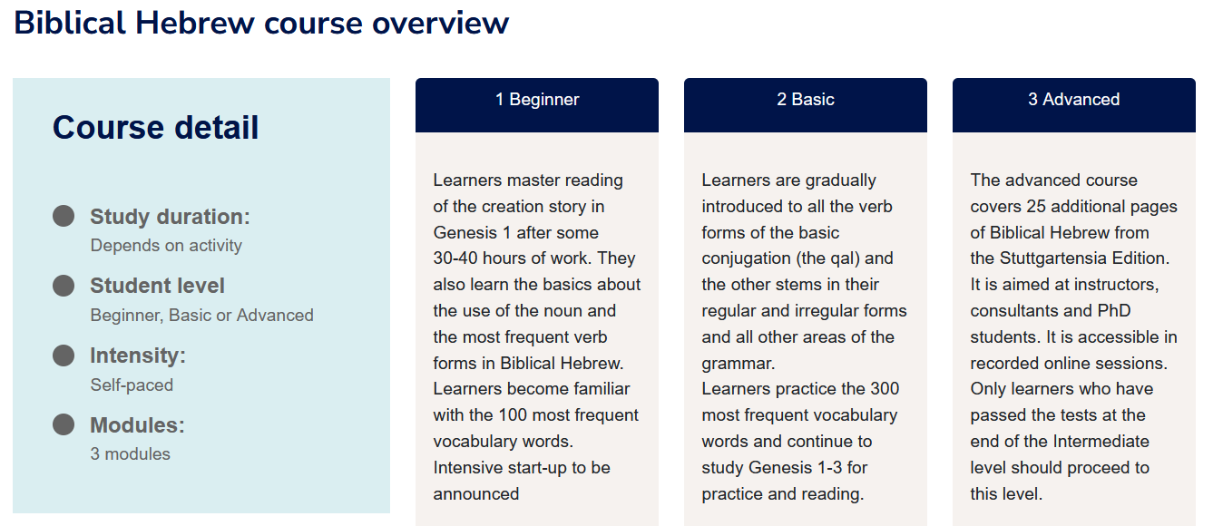
Three levels

Slide 43
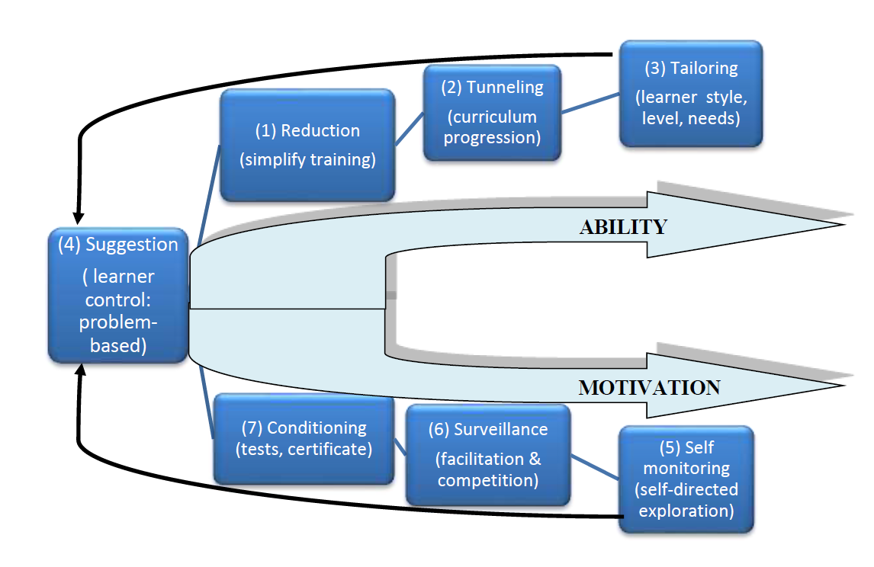
RAMP
Flow (2014)
From purpose
to relatedness (results)
Enable: (1) reduction> (2) tunneling> (3) tailoring
Motivate: (1) conditioning> (2) surveillance> self-monitoring

Slide 44
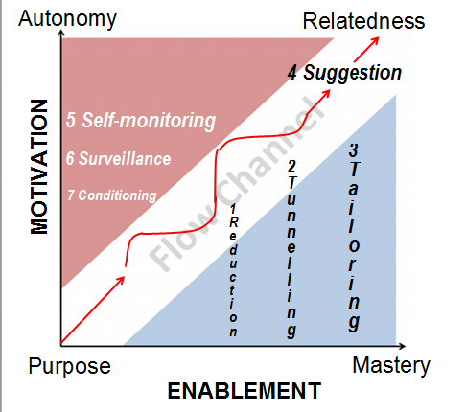
Launching RAMP (2014)
Results Ability Mastery Purpose (2014, p. 86)
Flow from purpose to relatedness/results
Enable: reduction > tunneling > tailoring
Motivate: conditioning> surveillance> self-monitoring
SUGGESTION

Slide 45
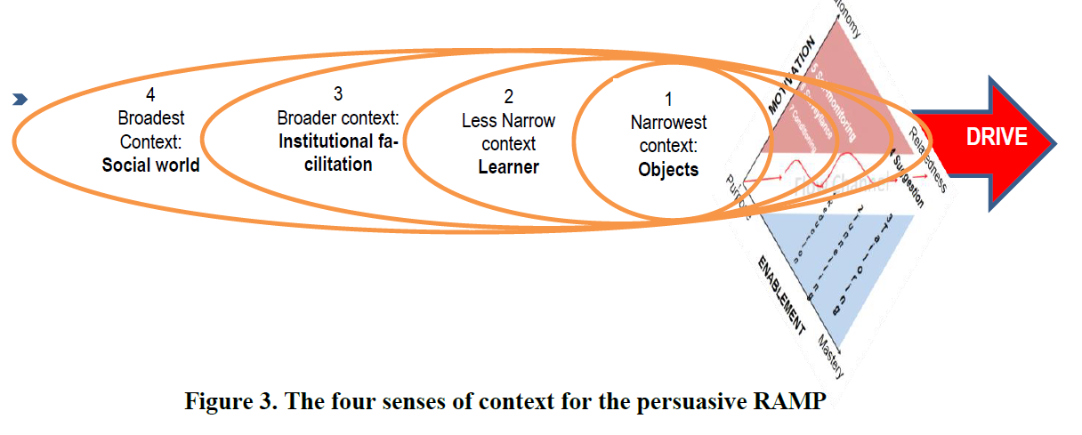
RAMP contexts
Four contexts (2014, p. 89 Figure)
From narrowest to broadest contexts of persuasive learning
Learning Content
Learner situation
Institutional setting
Social World

Slide 46
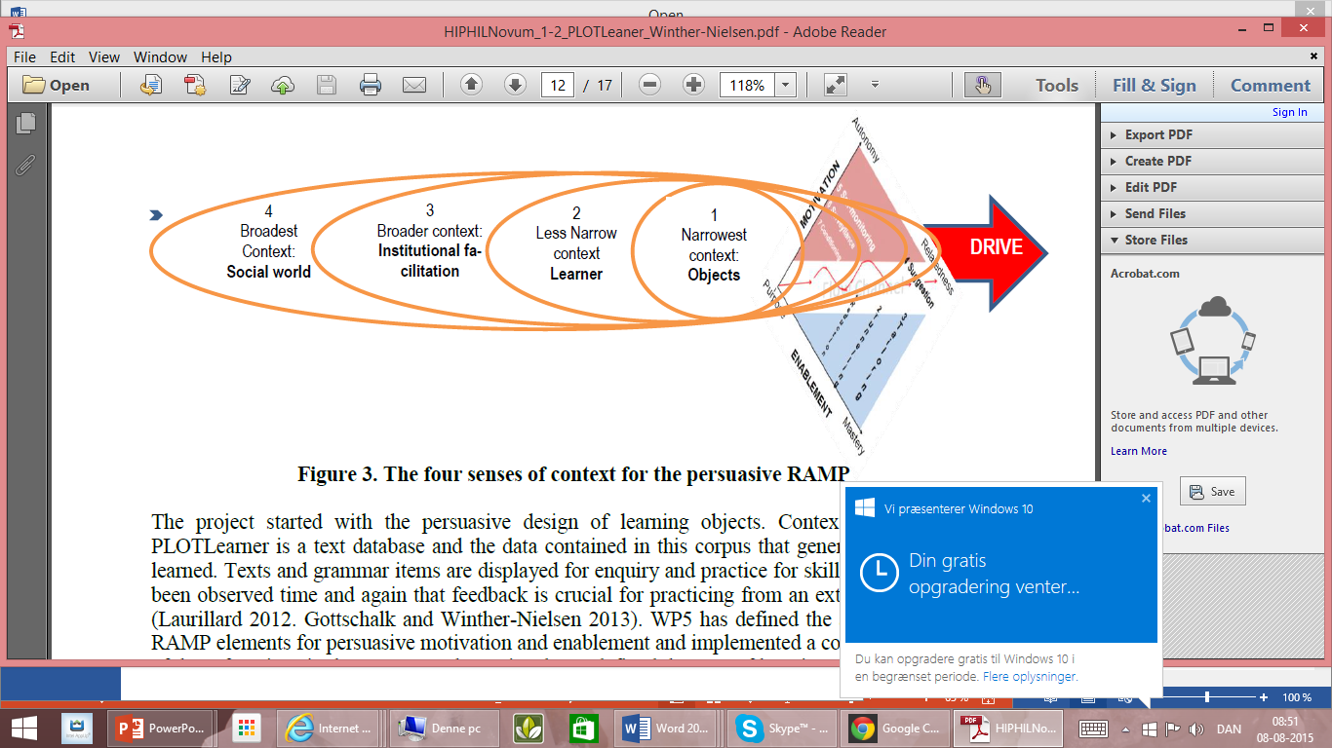
RAMP
Environment
Contexts
Content
Learner
Institution
World

Slide 47
3 persuasive reasons
ESSENTIAL: Greater global offline potential
EFFECTIVE: Hebrew easier and more enjoyable
EFFICIENT: Cheaper and deeper learning
Credibility (Fogg 156)
Trustworthiness (unbiased) > Hebrew database
Expertise (intelligent) > useful interface

Slide 48

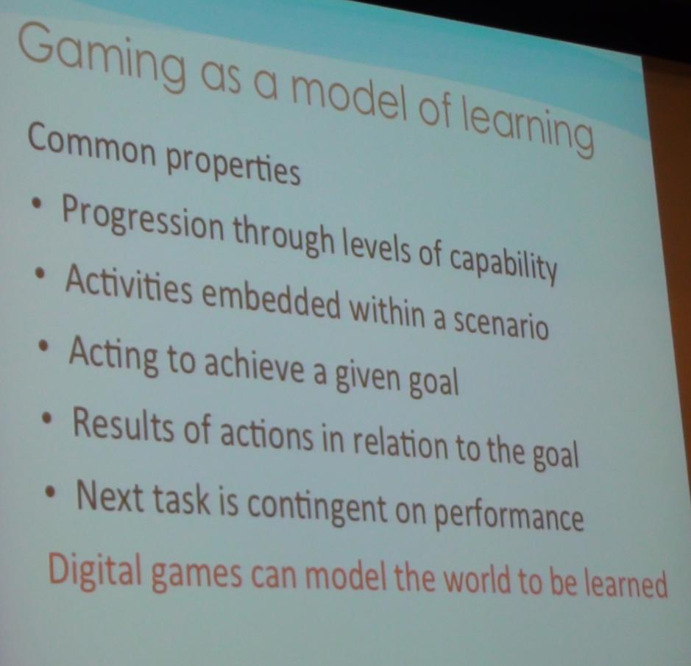
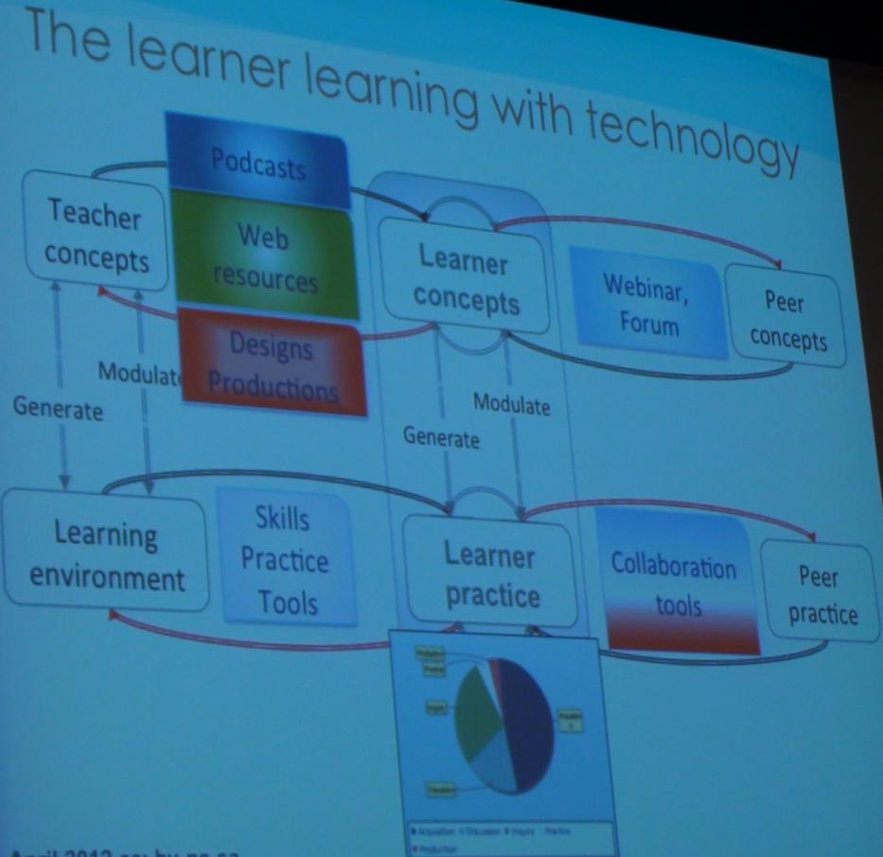
Design for Learning
Laurillard: Design science (2012)
  Actions for feedback
  Range of learning
  Integrate different technologies
PLOTLearner as persuasive gaming?

Slide 49
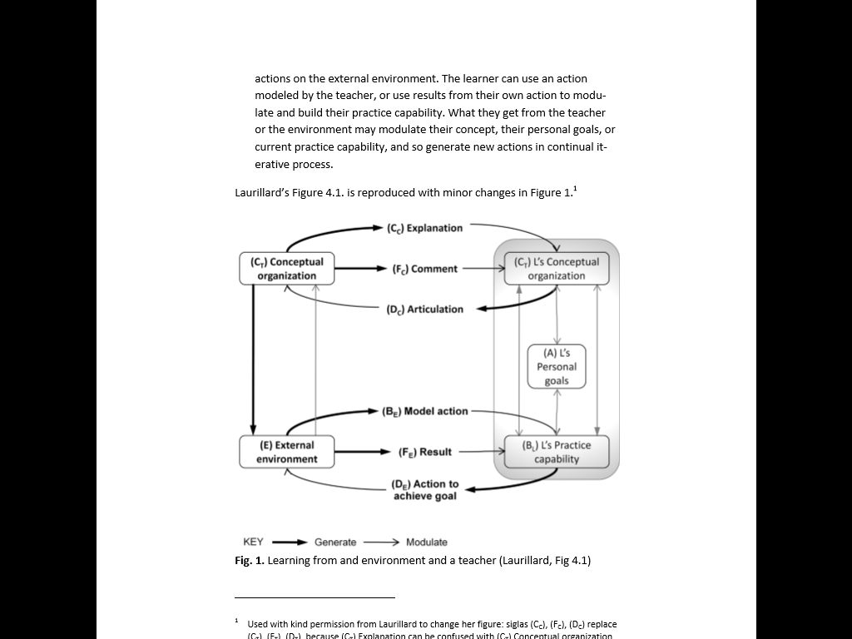

A plotted practice environment
Corpus, video
Exercises

Slide 50
Design for learning
Laurillard: Design science (2012)
Actions for feedback
Range of learning
Integrate different technologies
An interactive gaming environment?

Slide 51
.
…

